Slide 1
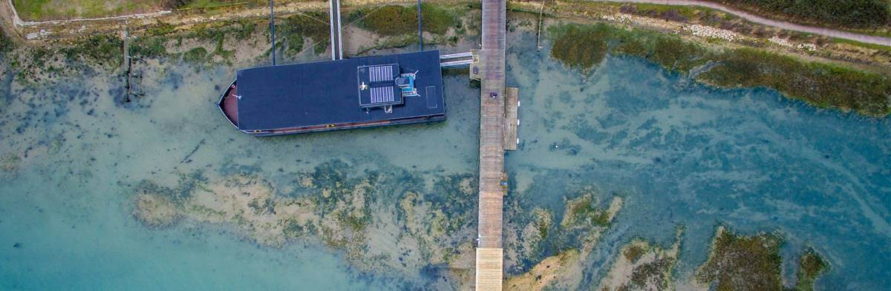
Year 6 Residential
6th - 10th July 2026
6L: 6th -8th July 6M: 8th – 10th July

Slide 2

‘CYE’ stands for ‘Christian Youth Enterprises’.
We are a charitable organisation and operate to exceptionally high professional standards. Underpinning this is our shared belief in the Christian faith. We endeavor at all times to show unconditional positive regard to every person who walks through our gate – regardless of ability, background or faith.
We also believe in living life to the full – an attitude that means our team gives 100% to every group we entertain – and we certainly do entertain!
It’s all about ‘the experience’. For some that’s an adrenalin-packed day on the water whilst for others it’s appreciating the stunning scenery, tranquility and wildlife in the harbor. Or perhaps it’s simply being looked after and getting away from the daily routine.
Whatever your reason for visiting CYE we want to go the extra mile to make your experience here a memorable one.

Slide 3
Adult Leaders
Mrs Williams (5 days)
Mrs Lewis (5 days)
Mr Jones (Mon – Wed)
Mrs Sharpe (Wed – Fri)
plus 1 more adult from school from 9 – 3 on Wednesday
We also have leaders from CYE working with us each day to run the activities, help with meals and free time.

Slide 4
Day 1
9:15am Leave school for CYE
10:15am Arrive
Introductions and safety talk
Settle into rooms
Lunch
Activity 1
Downtime
Dinner
Evening activity run by CYE
Bed

Slide 5
Day 2
Up and dressed
Breakfast
Tidy rooms and prepare for the day
Activity 2
Lunch
Activity 3
Downtime
Dinner
Evening activity run by CYE
Bed

Slide 6
Day 3
Up and dressed
Breakfast
Tidy rooms and prepare for the day
Activity 4
Lunch
Pack up
Leave CYE
Return to school for 3:20

Slide 7
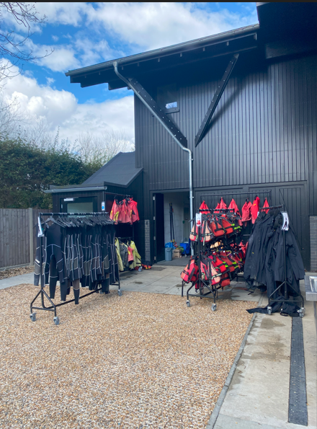
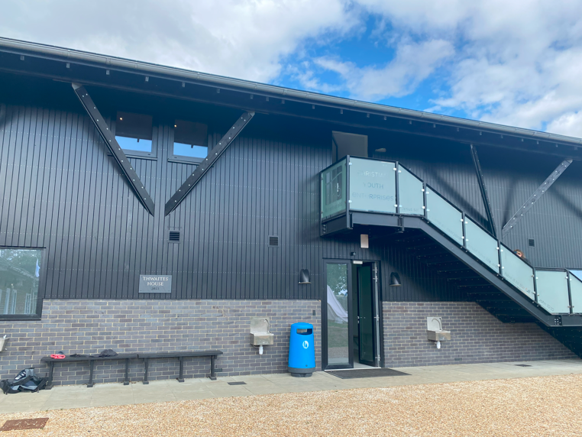
Facilities

Slide 8
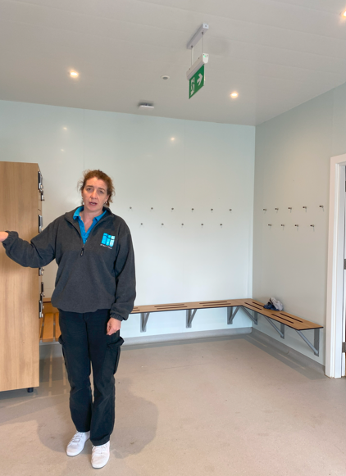
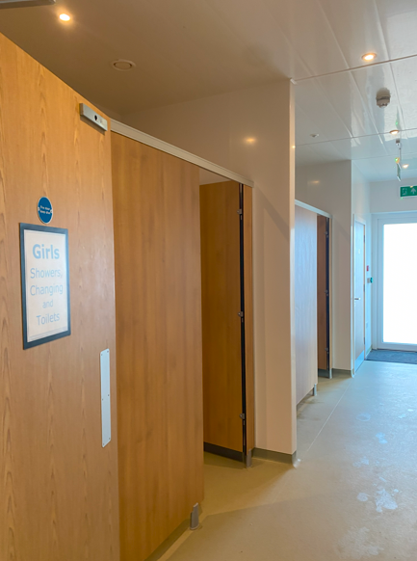
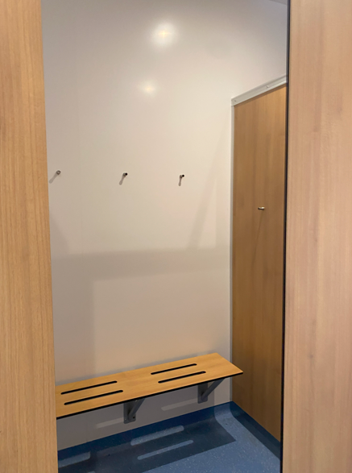
Changing facilities

Slide 9
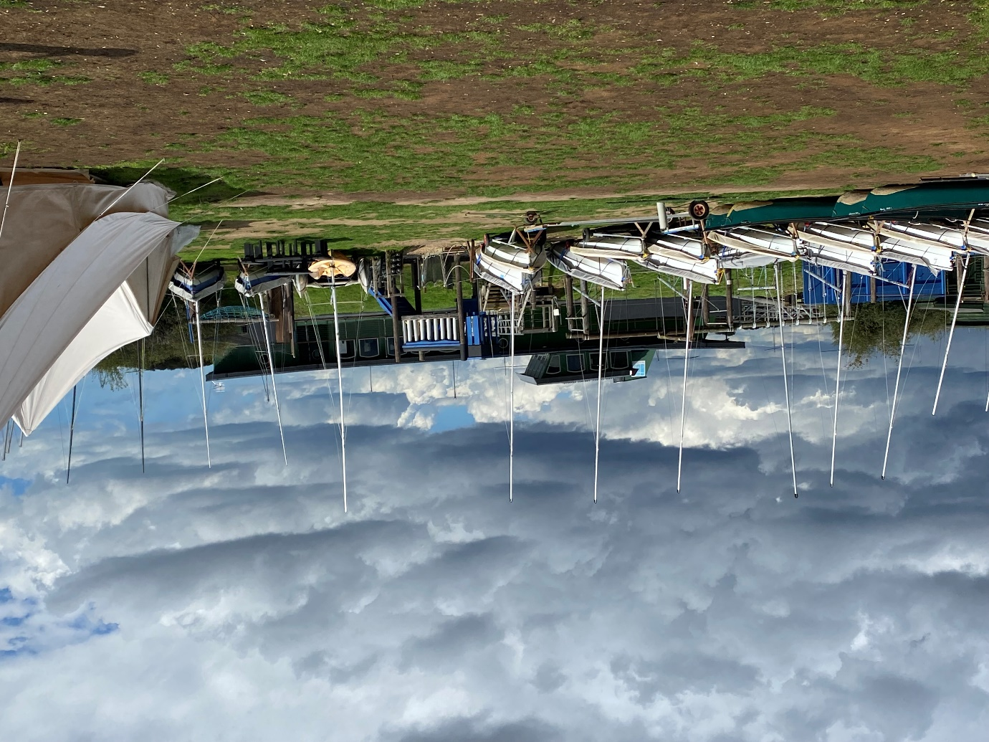
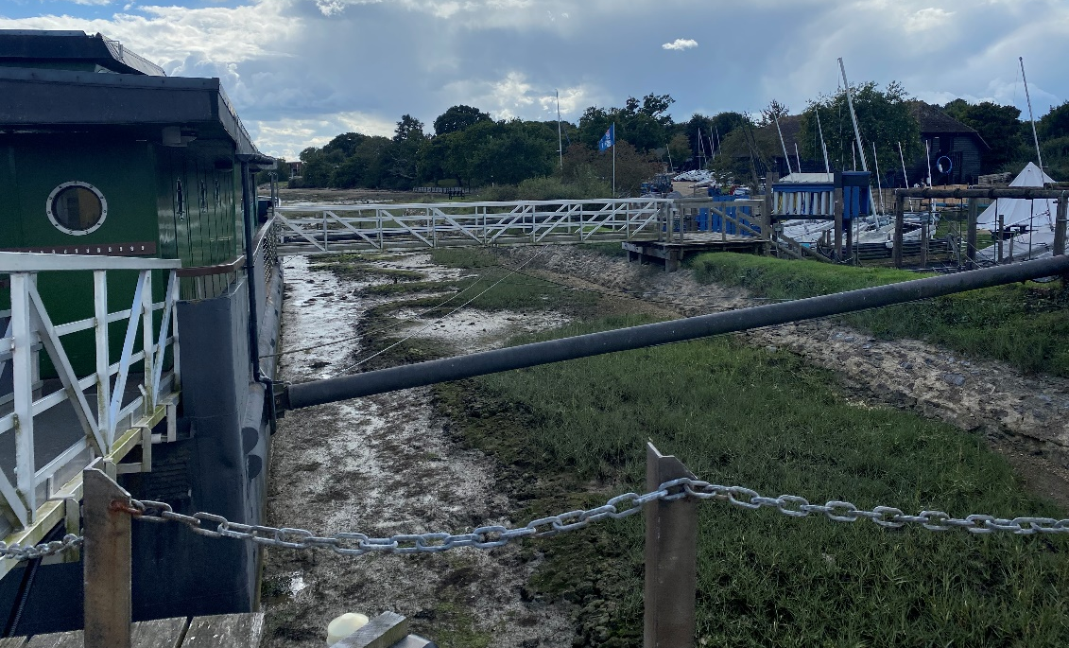
Accommodation

Slide 10
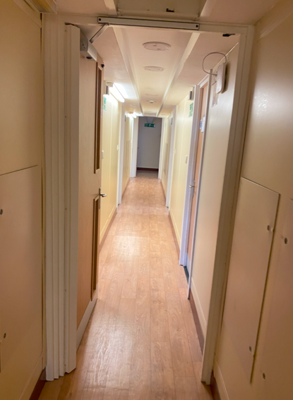
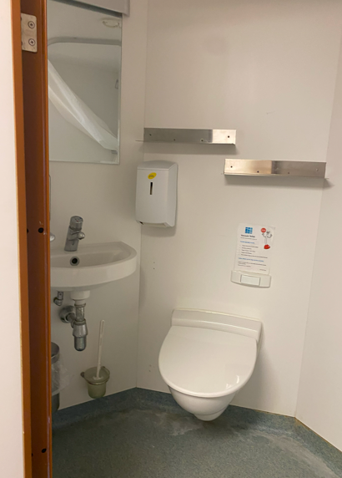
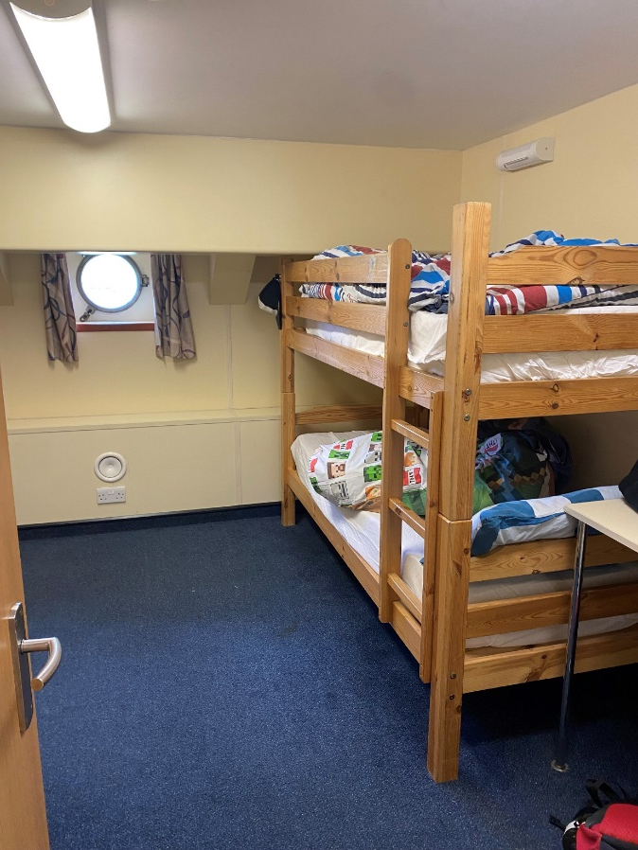
Accommodation

Slide 11
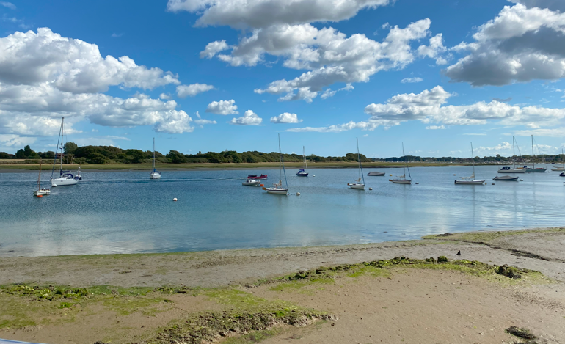

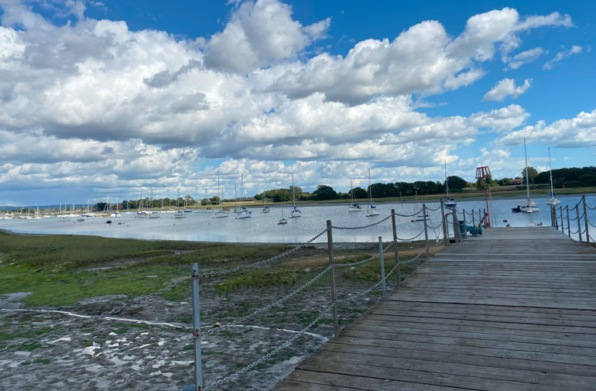
Views from the boat

Slide 12
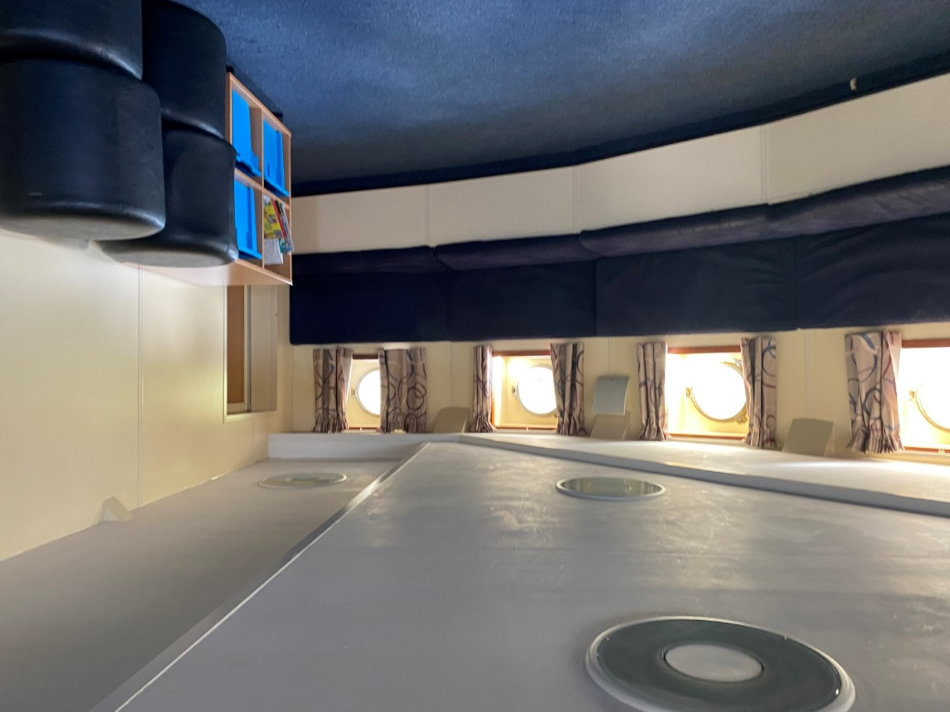
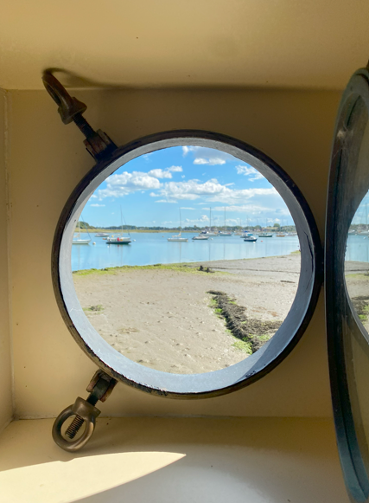
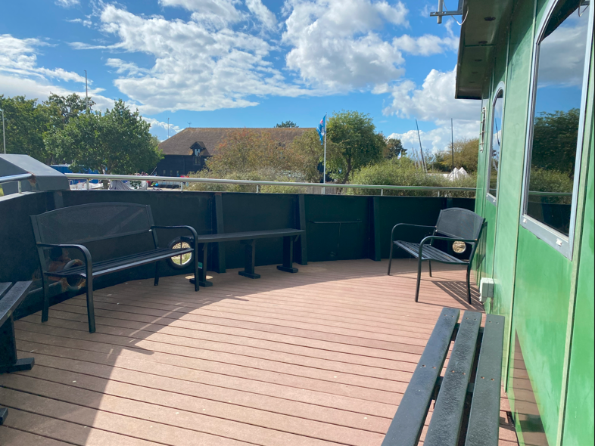
Downtime

Slide 13
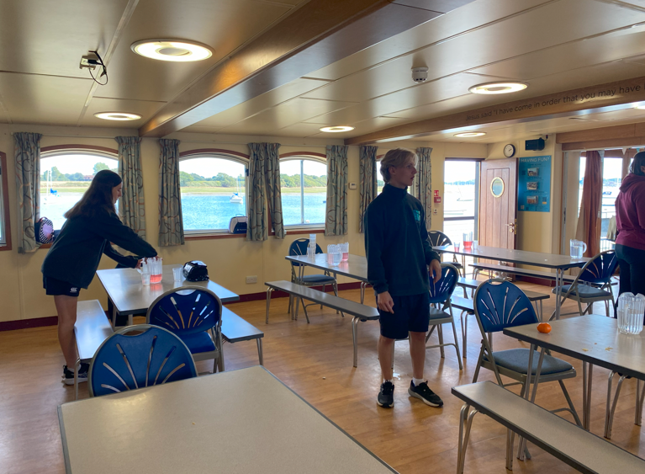
Great Home Cooking
Fantastic quality food and plenty of it! Our guests always build up healthy appetites, so we want the catering to be a memorable and central part of every day.
All our food is prepared and cooked on site from local fresh produce and feedback from our groups invariably mentions the outstandingly high quality provided – whether it’s a picnic hamper on East Head, an evening BBQ, or a sumptuous roast dinner.
All dietary requirements are catered for and our full-time professional catering manager is always happy to discuss any particular concerns you may have.

Slide 14

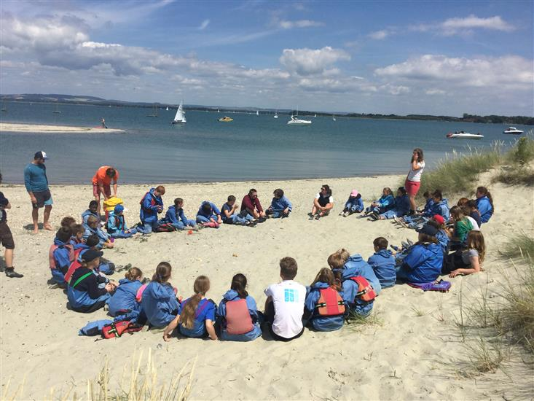

Activities

Slide 15
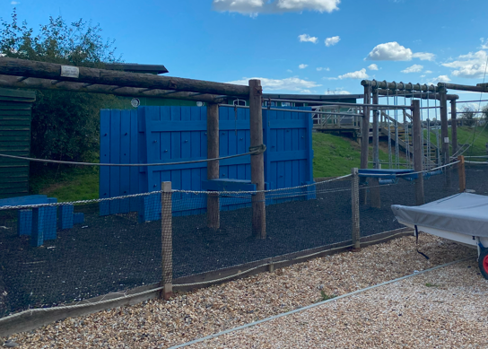
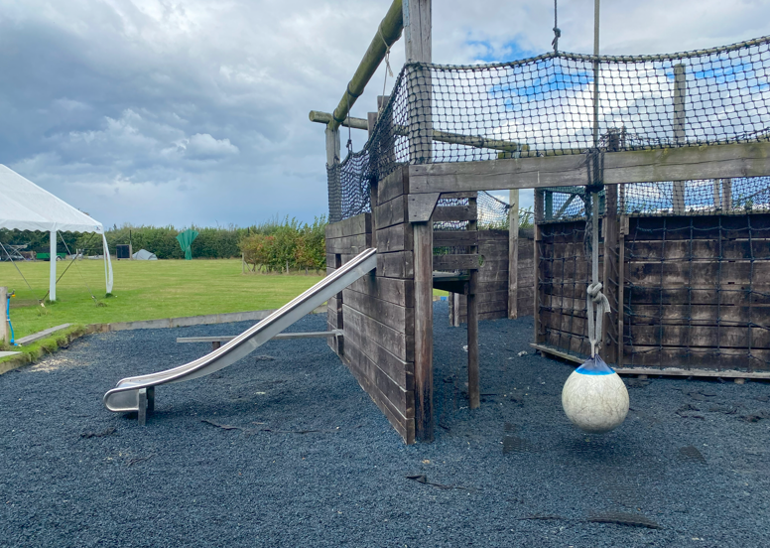
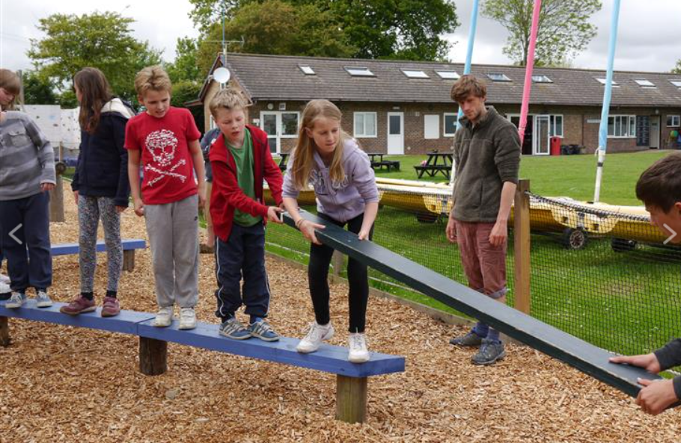
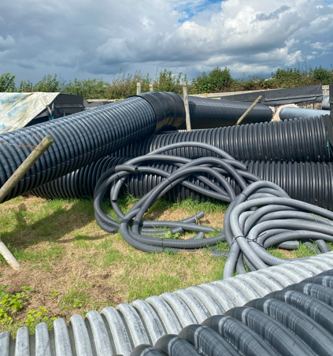
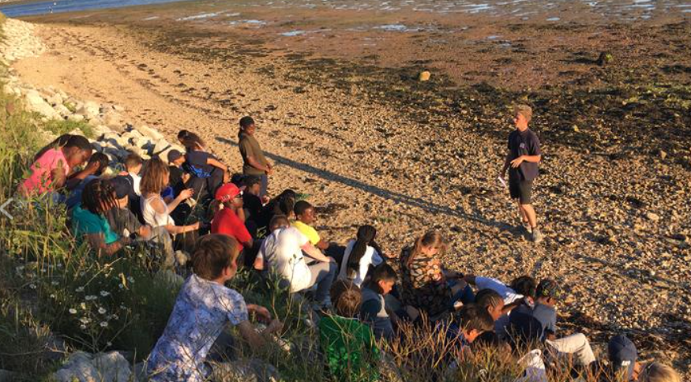
Activities

Slide 16
For the trip
Single duvet set and pillowcase (TBC)
Towel (showers) and quick drying swimming towel (water sports)
Swimming costume and rash vest/ old t-shirt
Book to read
Uno/Top trumps/playing cards
Small cuddly toy!
Bag for dirty washing
Water shoes or old trainers (will be soaked)

Slide 17
For the trip
Luggage:
  One Rucksack/holdall – with item list inside*
  One small backpack, to contain a water bottle, pen, pencil, paper, waterproof coat, SUN CREAM LOTION and a packed lunch for the first day only.
Clothing for journey:
  The children should wear outdoor ready clothes. They may wear leggings, trousers/tracksuit and suitable shoes.

Slide 18
For the trip
Clothes should be comfortable, consider lots of old clothes - you will definitely end up getting a bit mucky so don't bring anything too precious! Please ensure all are clearly labelled with your child’s name.
Hat and waterproof
Nightwear – Pyjamas
Underwear – 4 days’ supply
Socks – 4 days’ supply
Tops – Polo shirts, T Shirts etc (3 +)
Jumper – Warm sweatshirt or jumper, (2+)
Trousers – joggers, leggings, tracksuit (3+)
Swimming Costume
Footwear – 2 pairs of comfortable shoes for walking and doing outdoor physical activities (not brand-new ones), or trainers
Towel – 1 bath towel and 1 beach towel (preferably quick-drying)
Toiletries in washbag – soap, flannel, toothbrush, toothpaste, shampoo, hairbrush/comb, roll on deodorant, sun cream lotion and INSECT REPELLENT.
Sleeping bag and pillowcase

Slide 19
Please note
If your child requires any medication, please could you come and pick up a medication request form from the school office. With the exception of Paracetamol, all medicines for residential trips must be prescribed.
All medications (eg: for asthma, hay fever, eczema, nut allergy etc) including ibuprofen must be prescribed. They must be in-date, pharmacy labelled, provided in the original container as dispensed by a pharmacist and include instructions for administration, dosage and storage.
Please bring in on TUESDAY 1st July

Slide 20
Questions?
We hope your child is looking forward to it as much as we are!

