Slide 1
KEY STAGE TWO SATs Information Evening 2026

Slide 2

Tonight’s Aim:
This evening we hope to inform you a little more about what the KS2 SATs (Standard Assessment Tests) entail.

Slide 3
SATs Tests 2026
The SATs reflect the content in the National Curriculum taught at Key Stage 2.
The children will complete tests in the following areas:
Spelling, Punctuation and Grammar (SPAG)
Reading
Maths
Writing assessments are ongoing throughout the year and create a portfolio of evidence for teacher assessment.

Slide 4
SATs ASSESSMENT
Children will be given standardised scores. You will be given your child’s scaled score, from 80-120 where the ‘expected standard’ is 100, alongside the average for their school, the local area and nationally. Your child will receive their results when they get their reports in July.
There will also be a ‘performance descriptor’ of the expected standard for Year 6. In SPAG, Reading, Maths and Science children will be assessed as:
  Working below the expected standard - NS
  Meeting the expected standard – AS
As there is no test for writing and science, we will give a Teacher Assessment judgement.

Slide 5
WRITING

Slide 6
Writing
There is no writing paper for the SATs, however it will be teacher assessed and this will be shared with parents when the rest of the SATs results are handed out with the reports. Spelling and punctuation are also vital for the children to achieve the expected standard. Children must meet all of the following objectives, writing for a range of purposes and audiences, to meet the expected standard, it is not a best fit model.
Children will be assessed as one of the following:
Working Towards the Expected Level
Working at the Expected Level
Working at the Expected Level with Greater Depth

Slide 7
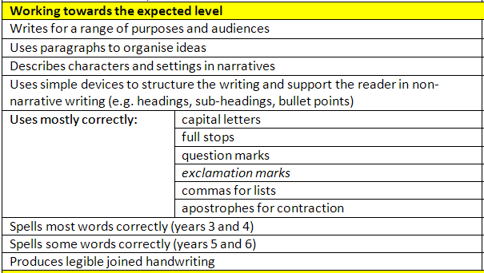

Slide 8
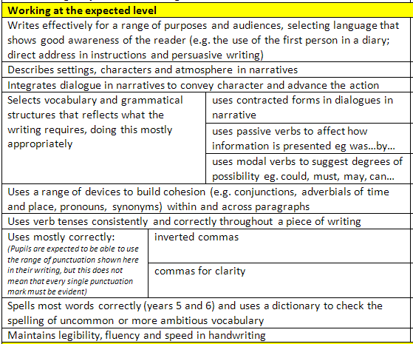

Slide 9
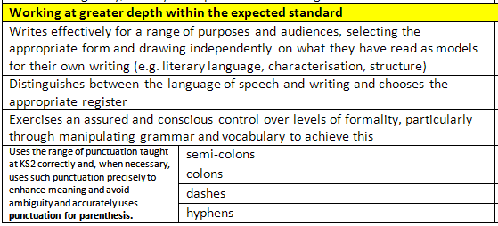

Slide 10
SATs TIMETABLE
Date | Tests
Monday 11th May | English Grammar, Punctuation and Spelling (SPAG) tests
Tuesday 12th May | English Reading test
Wednesday 13th May | Mathematics – Paper 1 – Arithmetic Mathematics – Paper 2 – Reasoning
Thursday 14th May | Mathematics – Paper 3 – Reasoning

Slide 11
Monday 11th May
Grammar, Punctuation and Spelling

Slide 12
Spelling, Punctuation and Grammar Test
Grammar and punctuation paper requiring short answers (45 minutes)
Spelling test of 20 words (approx 15 minutes)
Types of questions:
Selected response, e.g. ‘Identify the adjectives in the sentence below’
Constructed response, e.g. ‘Correct/complete/rewrite the sentence below,’ or, ‘The sentence below has an apostrophe missing. Explain why it needs an apostrophe.’

Slide 13
GRAMMAR AND PUNCTUATION

Slide 14
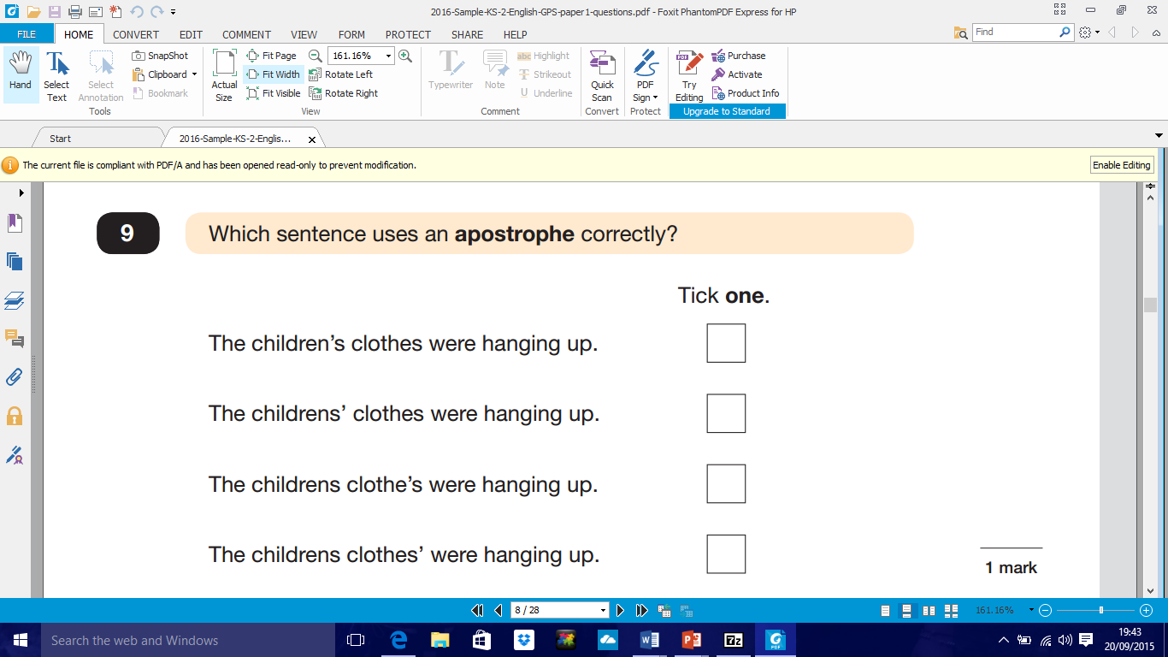

Slide 15
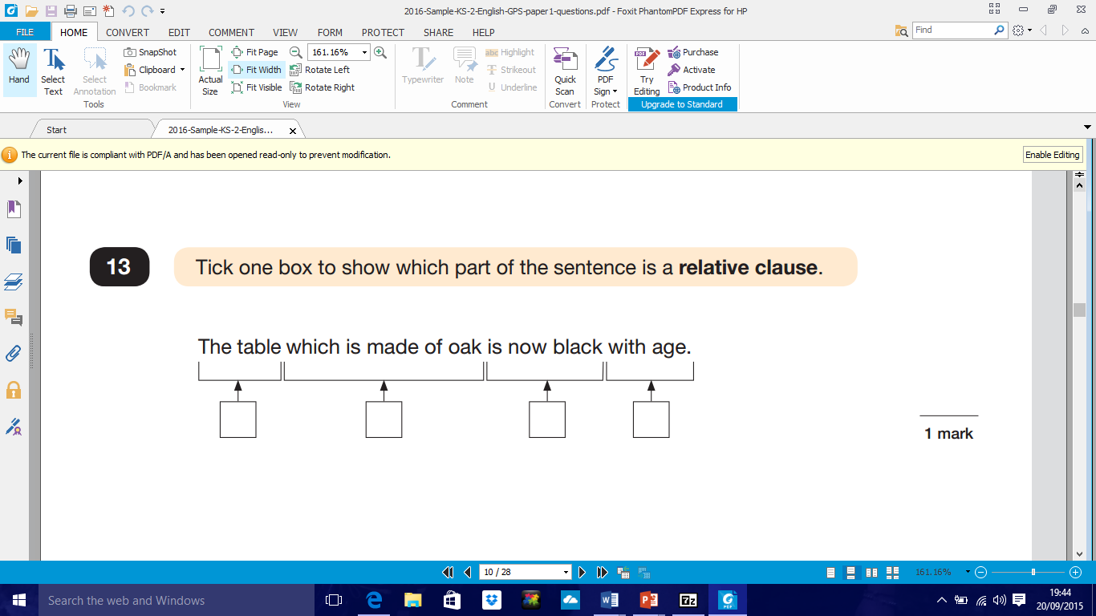

Slide 16
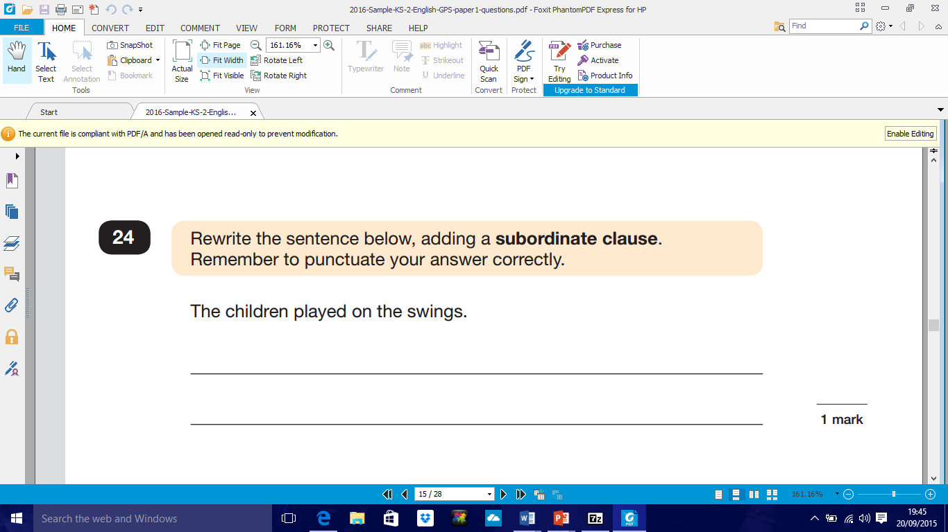
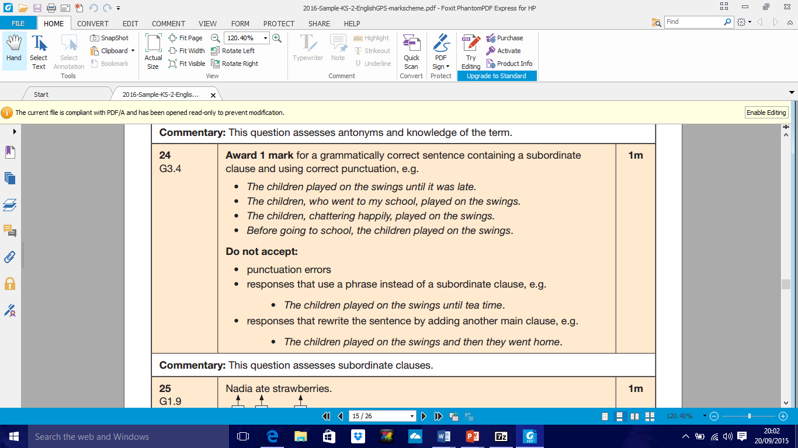

Slide 17
SPELLING

Slide 18
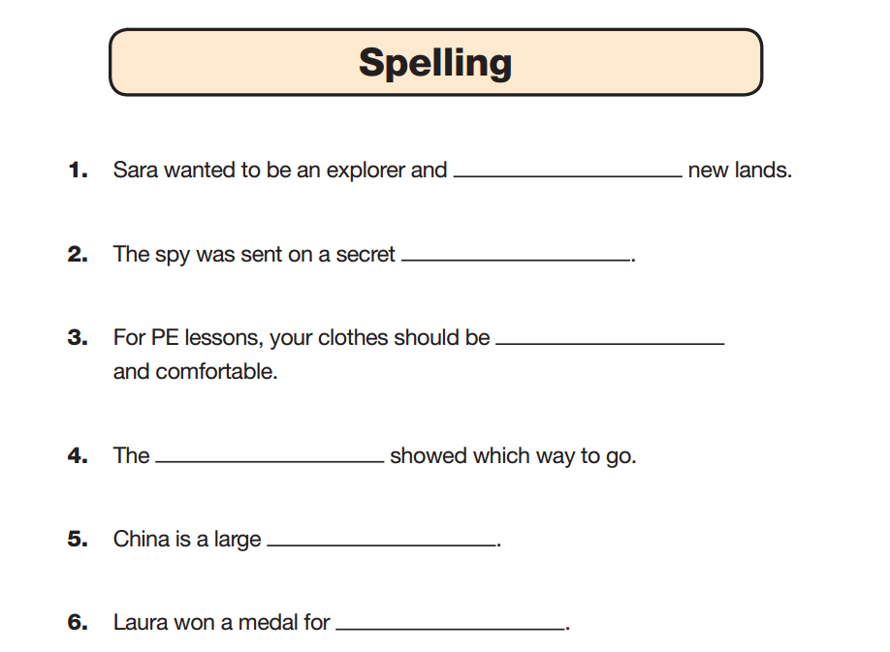
discover
mission
loose
sign
country
gymnastics

Slide 19
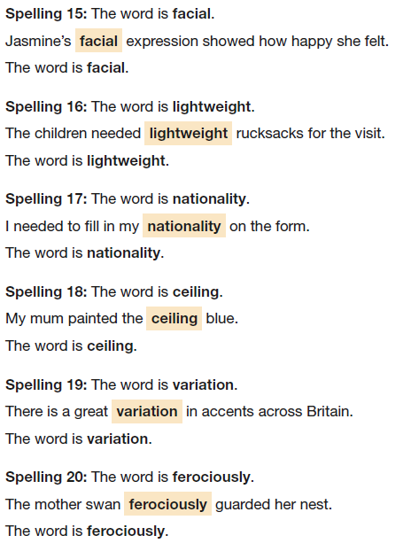

Slide 20
Tuesday 12th May
Reading

Slide 21
Reading Paper
The children will be assessed on a range of reading skills, such as the ability to interpret information and comment on writers' use of language, and they’ll have to demonstrate accurate punctuation and an extensive vocabulary in a piece of writing.
The reading test will be a single paper with questions based on three passages of text, including fiction, non-fiction and poetry.
Children will have one hour, including reading time, to complete the test.

Slide 22
Types of questions:
Ranking/ordering, e.g. ‘Number the events below to show the order in which they happen in the story’
Labelling, e.g. ‘Label the text to show the title of the story’
Find and copy, e.g. ‘Find and copy one word that suggests what the weather is like in the story’
Short constructed response, e.g. ‘What does the bear eat?’
Open-ended response, e.g. ‘Look at the sentence that begins Once upon a time. How does the writer increase the tension throughout this paragraph? Explain fully, referring to the text in your answer.’

Slide 23
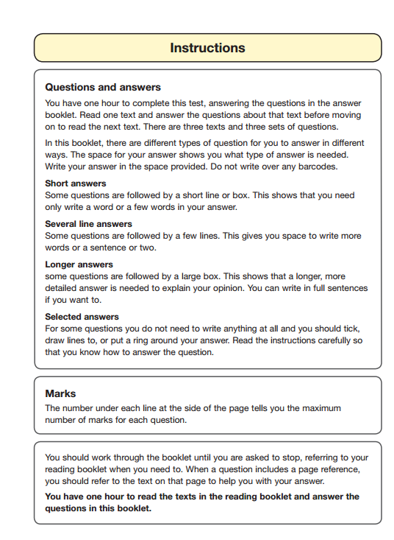

Slide 24
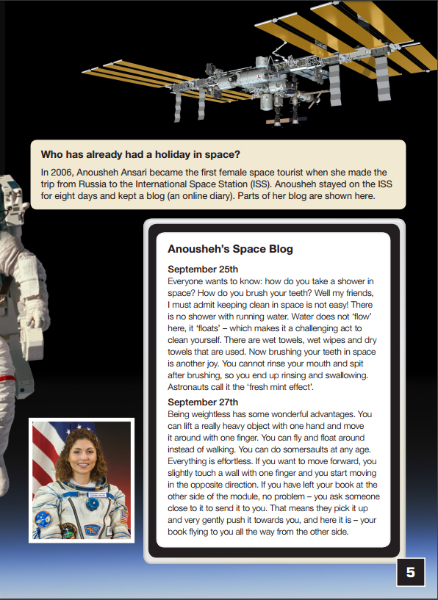
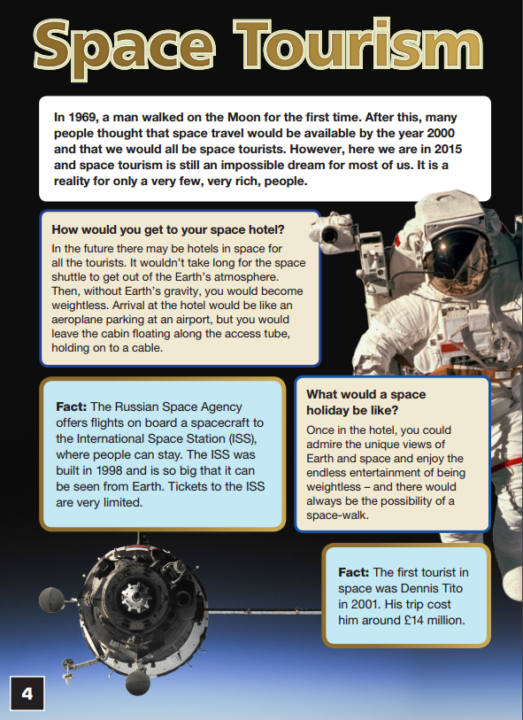

Slide 25
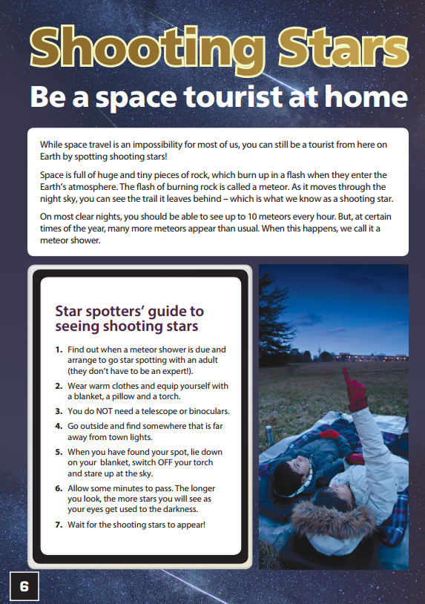

Slide 26
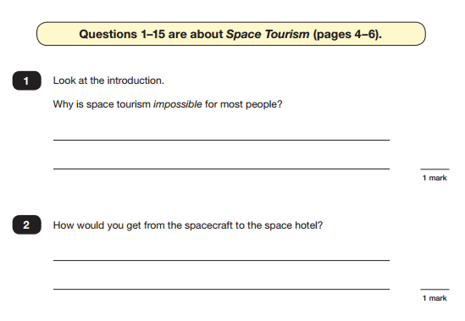

Slide 27
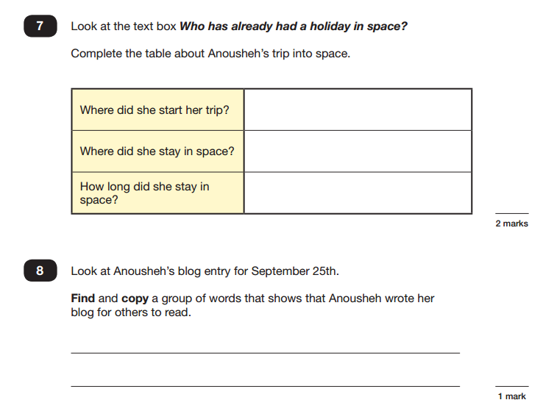

Slide 28
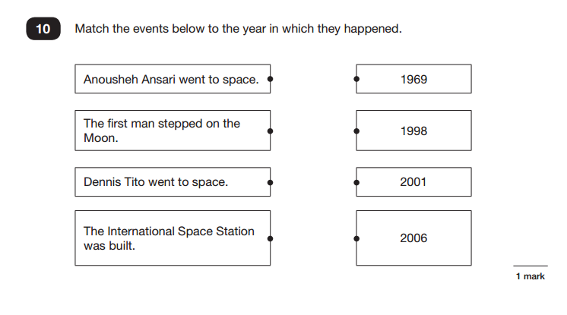

Slide 29
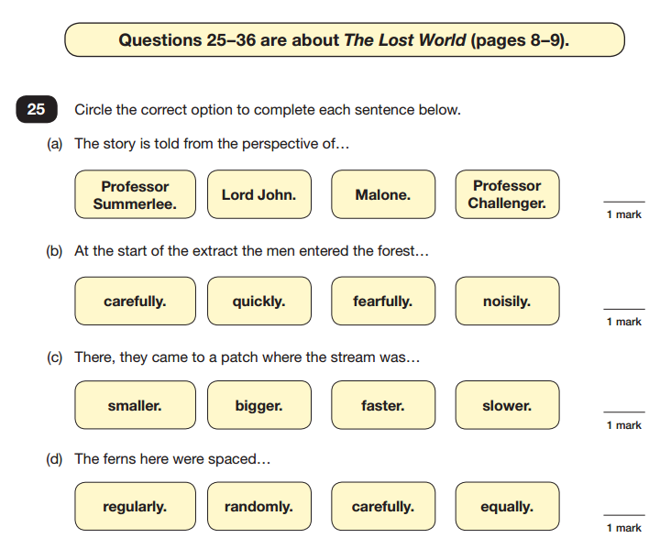

Slide 30
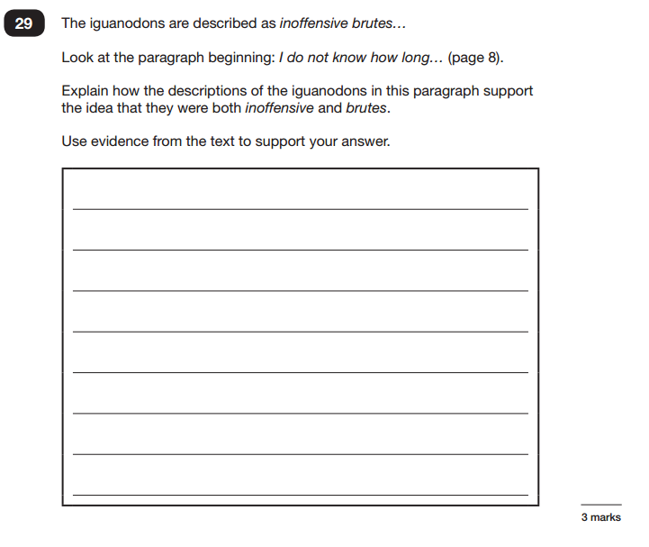
Point
Evidence
Explanation
Link

Slide 31
Wednesday 13th May
Arithmetic and Reasoning 1
Thursday 14th May
Reasoning 2

Slide 32
Maths
Children will be assessed on a range of core skills (some mentally), including knowing all times tables and using them to divide and multiply, using a protractor to measure angles, calculating the perimeter and area of shapes, solving problems by collecting and using information in tables, graphs and charts and solving problems involving ratio and proportion.
Children will sit three papers in maths:
Paper 1: arithmetic, 30 minutes
Papers 2 and 3: reasoning, 40 minutes per paper

Slide 33
Paper 1 (Arithmetic) will consist of fixed response questions, where children have to give the correct answer to calculations, including long multiplication and division. Some will involved a mental calculation whereas some will require a formal method of workings out.
Papers 2 and 3 (Reasoning) will involve a number of question types, including:
Multiple choice
True or false
Constrained questions, e.g. giving the answer to a calculation, drawing a shape or completing a table or chart
Less constrained questions, where children will have to explain their approach for solving a problem

Slide 34
ARITHMETIC

Slide 35
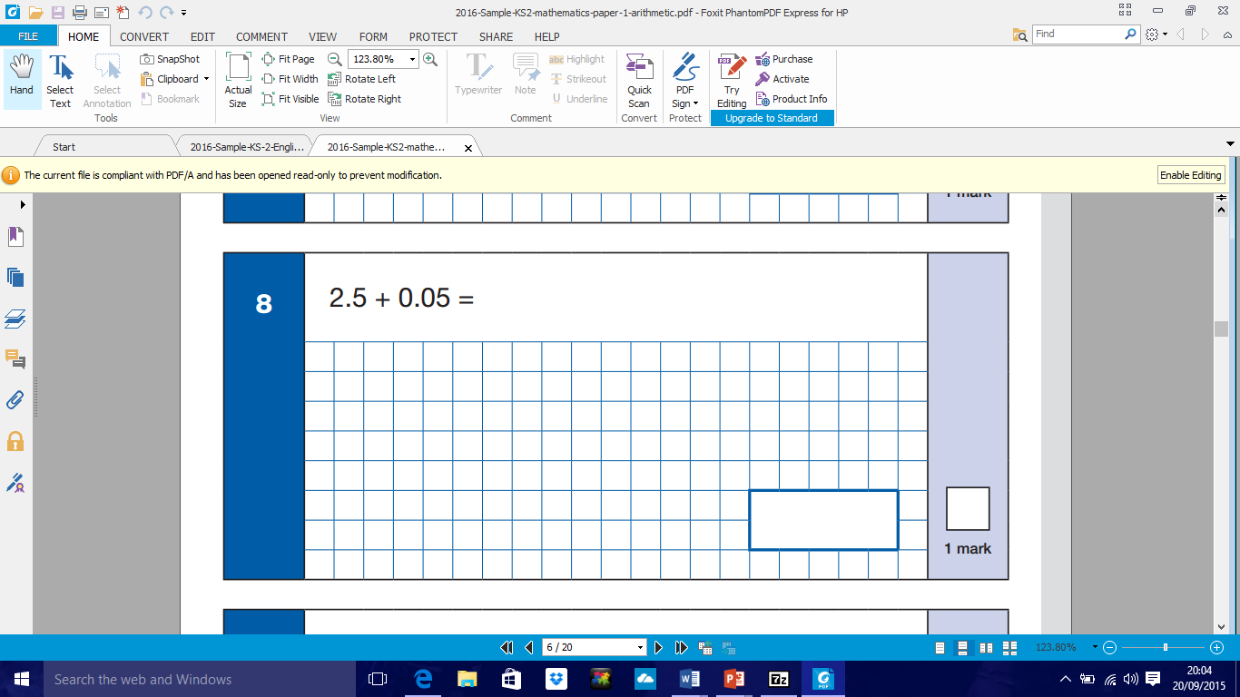

Slide 36
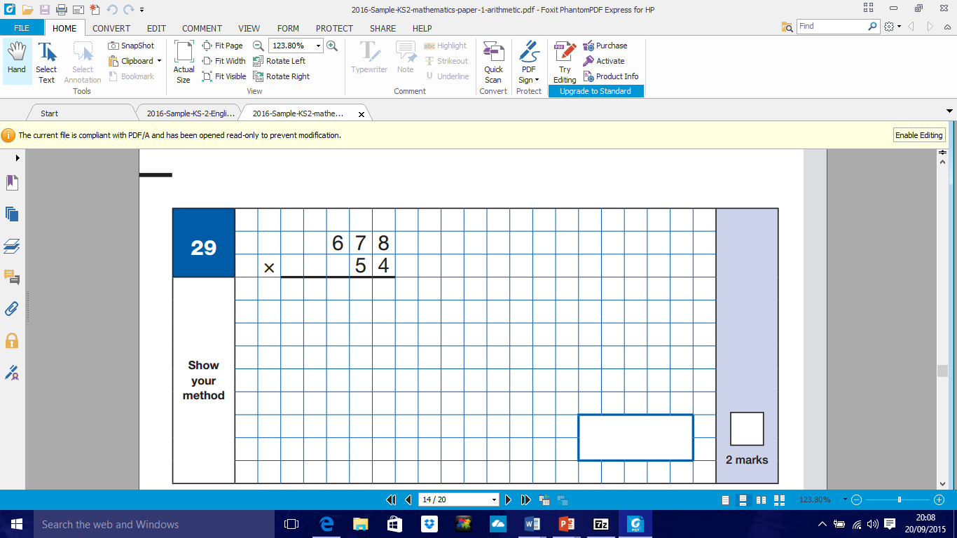

Slide 37
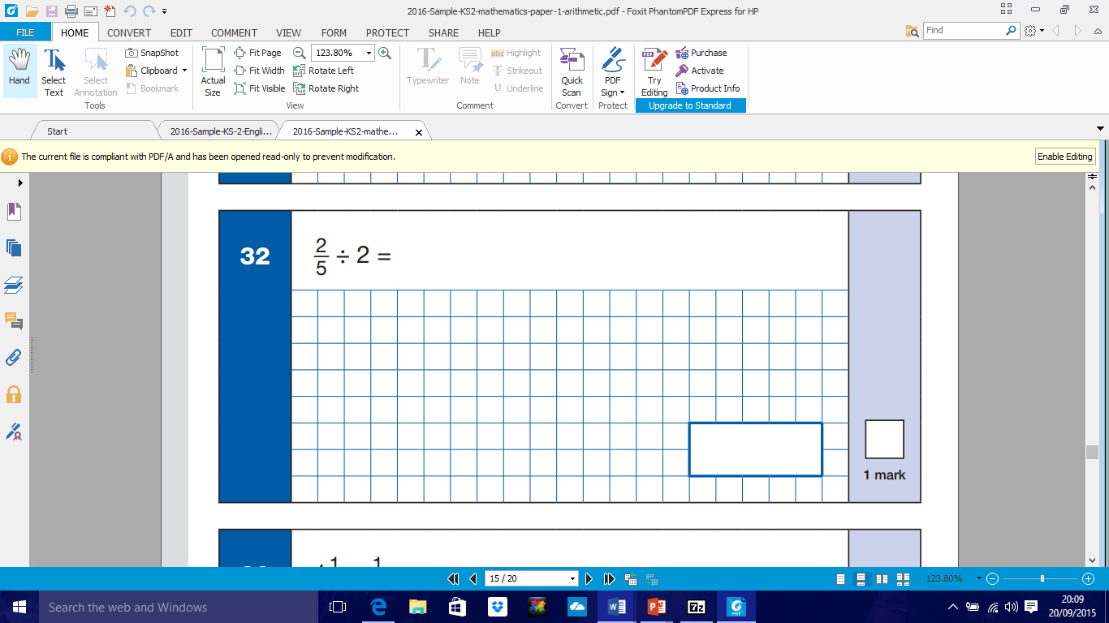

Slide 38
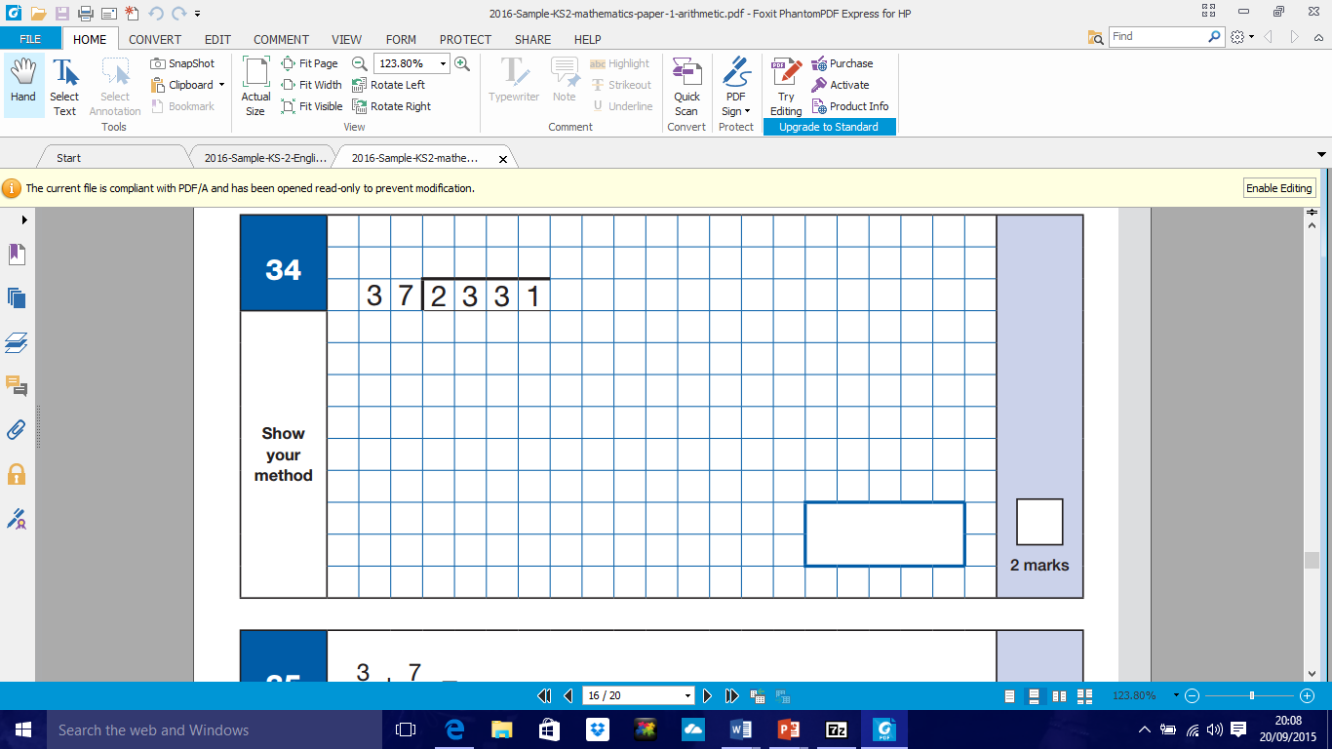
https://www.st-thomas.surrey.sch.uk/learning/parent-learning-workshops/

Slide 39
REASONING

Slide 40
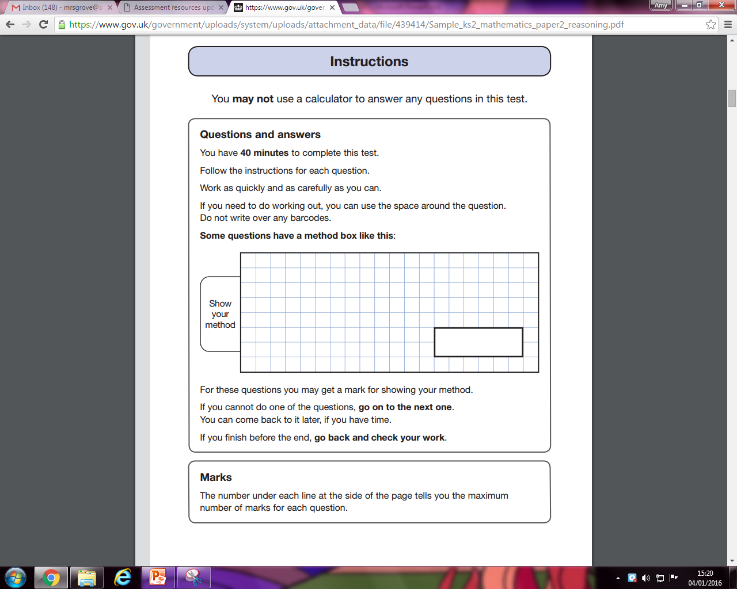

Slide 41
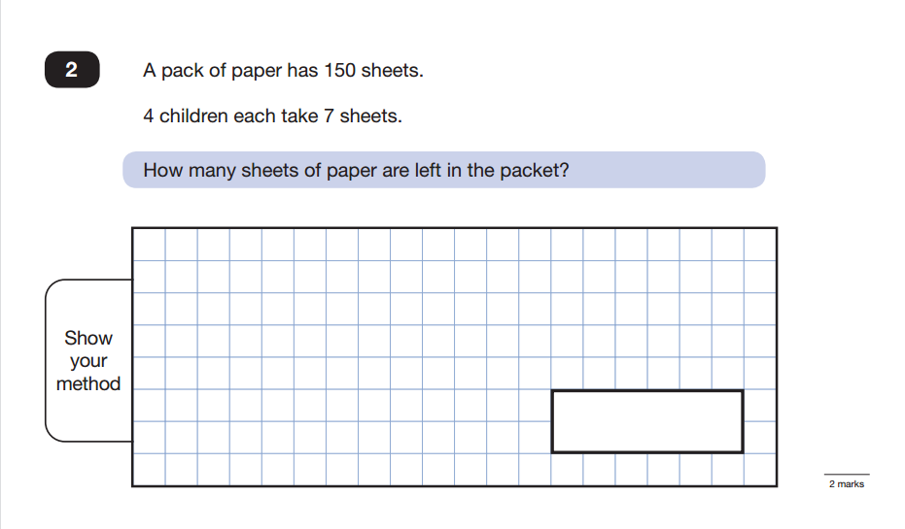

Slide 42
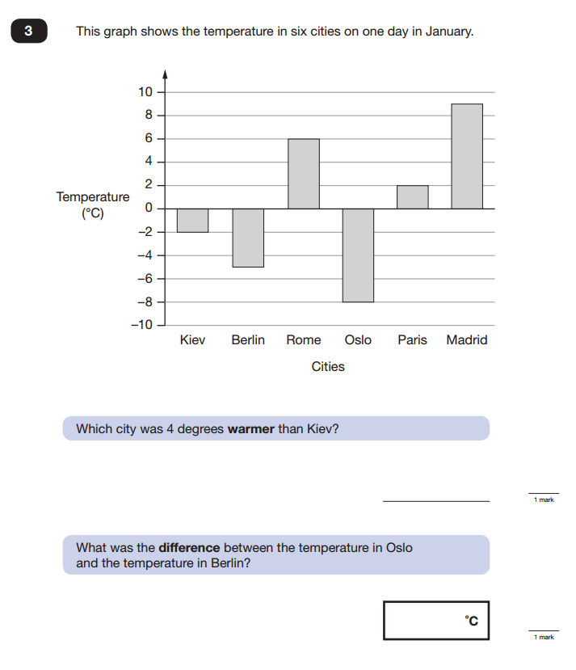

Slide 43
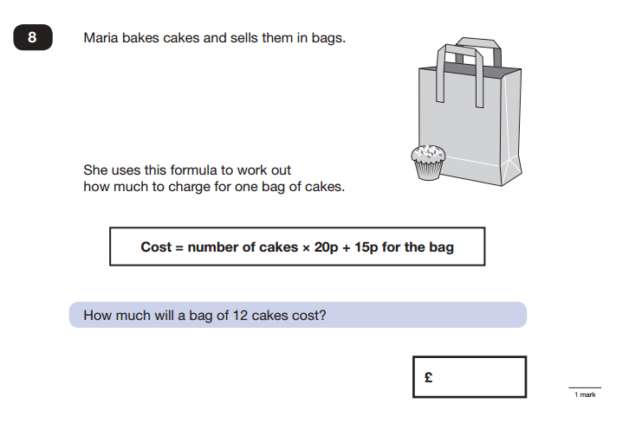

Slide 44
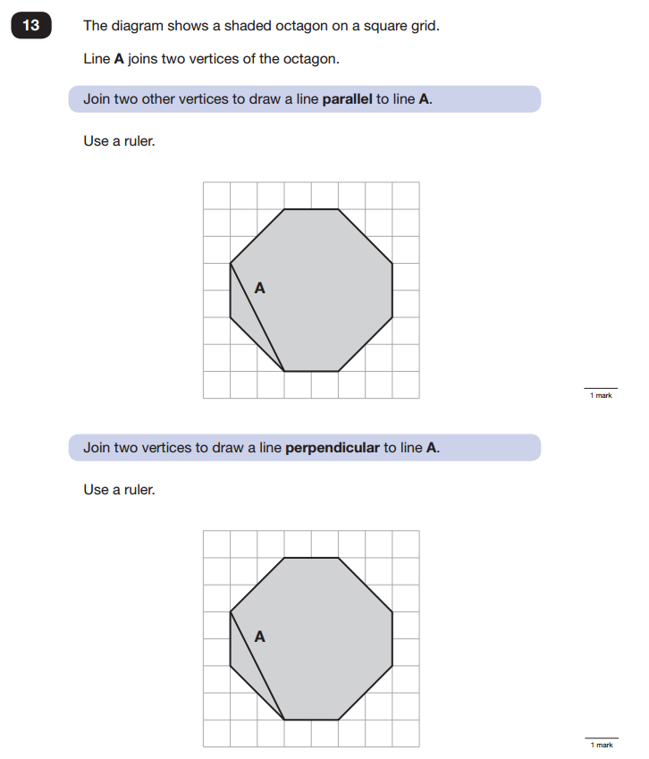

Slide 45
How are the children prepared in school?
Through our everyday teaching and balanced curriculum
We practise! Mock SATs – W/C 19th March
The children are able to become familiar with the layout and design of previous tests e.g. marks
They become used to the test procedures; independent work, style of questions, time limits
They know that the Maths test is not a reading test so they can have help reading questions
Focused teaching groups

Slide 46
How can I help my child?
Homework will focus on what they need to know for the tests, including types of questions and vocabulary
  Learn all the time tables and associated divisions facts up to 12 x 12
  Practise standard methods of addition, subtraction, multiplication and division
  Learn different (and perhaps new!) grammatical terminology
  Practise and learn spelling rules with children (including list in reading records)
  Plenty of reading and answer questions about reading books using the prompt sheets in reading records with a focus on inference questions
Revision – a little at a time / often
Regular attendance at school
Plenty of sleep!
Support, encouragement and praise!

Slide 47
Even more reading…
Recommended book list
Audio-books
How will reading quality texts help?
TT Rock Stars
Have a go at their CGP books with them!

Slide 48

We hope you have found tonight informative.
Any questions or queries please do not hesitate to contact anyone in the Year 6 team, we will always be willing to help.
Together, we can work in partnership so that your child can reach their full potential.

