Slide 1

Parent Workshop
Monday 20th March 2023
Making S=P+A+C+E for Me

Slide 2

Aims of this Session
To update you on our Mental Health & Wellbeing provision- what we do in school.
To reflect upon parenting styles and what parents can do to promote good mental health.
To share some great resources and sources of support.

Slide 3

Our Main Aims 2022-23

Slide 4
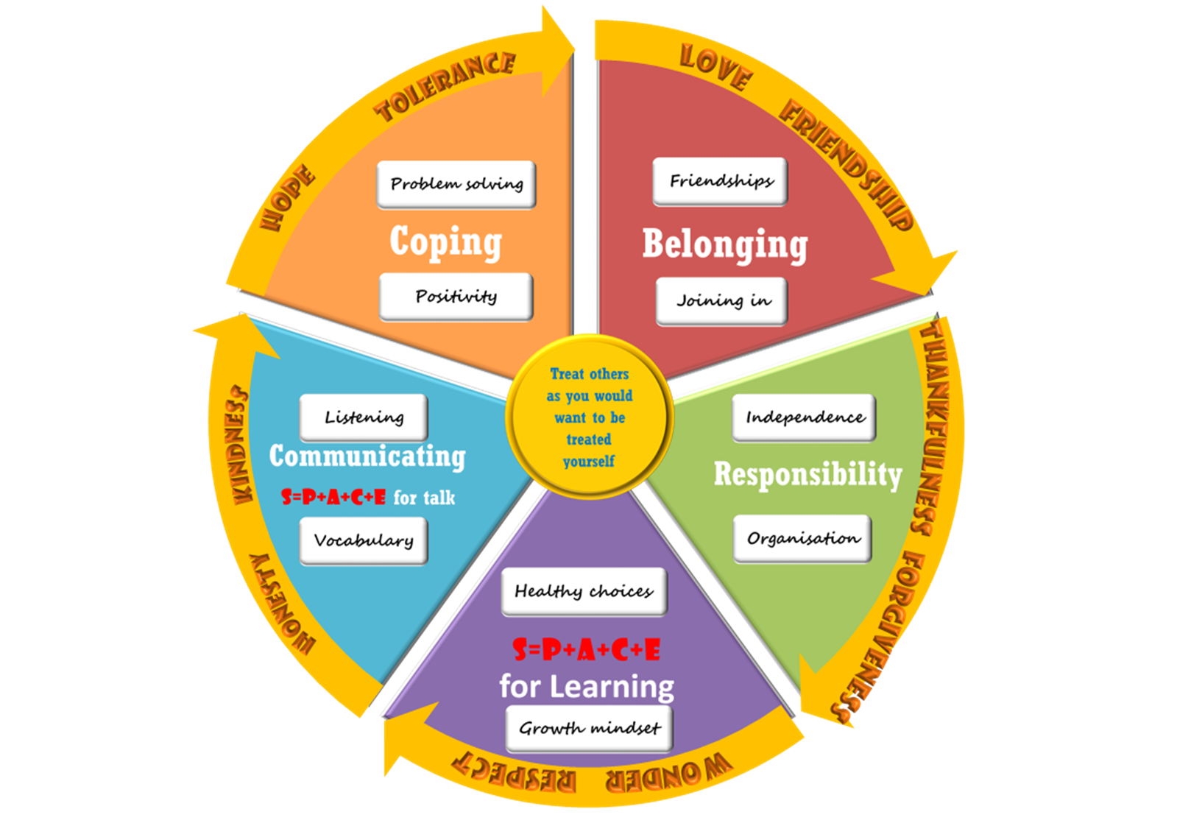
S=P+A+C+E for me

Slide 5


Coping..
Dr Matthew Patrick
Maudsley Hospital
Dr Matthew Patrick - Chief Executive of South London and Maudsley NHS Foundation Trust.
“promoting resilience… and coping with challenges.”

Slide 6
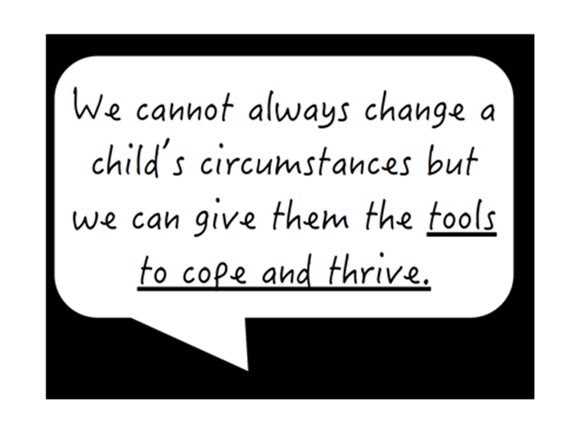

Slide 7
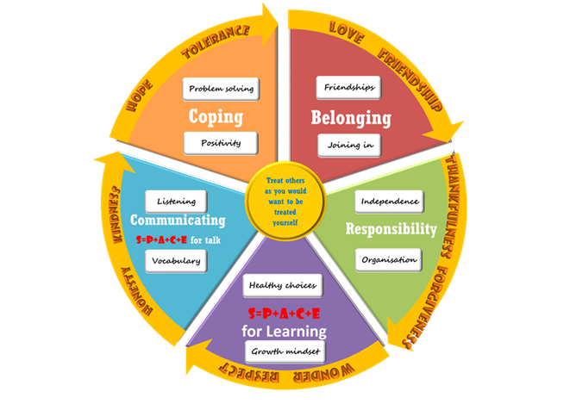
Coping…
If they do share a worry or concern give them the tools to solve it – (talk to the teacher) but equip your child too. As parents we cannot “solve” everything for them.
Give them some strategies/ ways to solve the problem themselves first.

Slide 8
Belonging…
These promote:
School
Family
Church community
Other clubs/ activities
Social connectedness with a supportive peer group
Passion
An interest, hobby or skill that the child highly values in themselves
Where do they feel they belong?
To consider joining a club.
To be able to play with a wide range of people- opportunity to make new friends,
To be able to work with a range of people/ different learning partners.

Slide 9
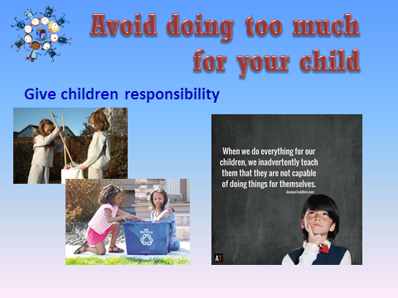

Responsibility…

Slide 10
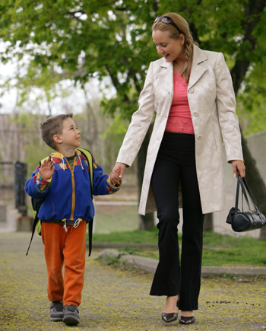

Communicating
One-to-one time together
Reading
    Language
    Talking
Notes:
Do spend one-on-one time with your child. Whether it's grabbing a bite to eat or taking a bike ride, try to schedule some alone time with your child at least once a week. This is a great opportunity to talk about what's on her mind and to cement the bond the two of you share.

Slide 11
You’re never too young to talk about mental health
Make conversations about mental health a normal part of life – just like physical health…
Some ways to start a conversation about feelings might be:
  “How are you feeling at the moment?”
  “You don’t seem your usual self. Do you want to talk about it?”
  “Do you fancy a chat?”
  “I am happy to listen if you need a chat?”
Ask open questions
Stay calm with the feelings that arise
Offer empathy rather than solutions

Slide 12
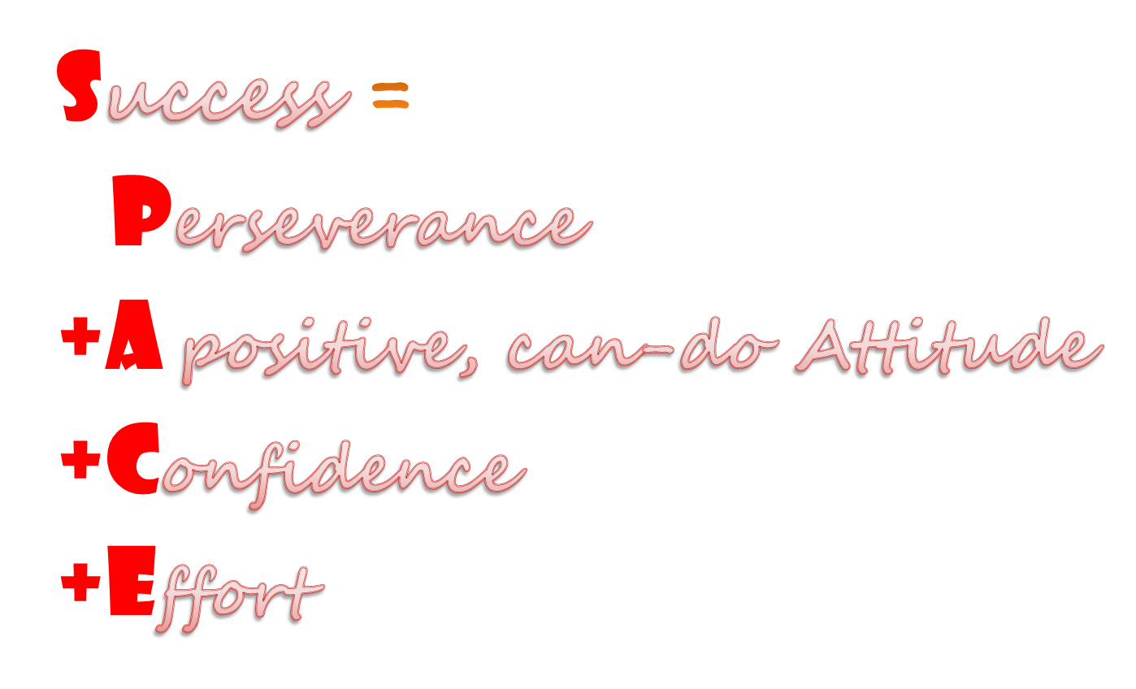
S=P+A+C+E for learning
Use language of positive learning habits
Praise effort rather than outcome
Value homework
Read with and to your child
Role model

Slide 13
S=P+A+C+E for learning
Perseverance
A St Thomas’ Learner…
Never gives up
tries and tries again
Isn’t afraid to get things wrong
Is resilient
Always gets involved and has a go
A positive, can-do Attitude
A St Thomas’ Learner…
Believes in themselves
Has a GROWTH mindset
Wants to take part
Is always optimistic
Encourages others
LOVES LEARNING
Confidence
A St Thomas’ Learner…
Is happy
Knows they CAN
Believes in the power of yet
learns from their mistakes
Is happy to share
Knows they are valued and loved
Effort
A St Thomas’ Learner…
Is always ready to learn
Listens
Isn’t distracted
Makes good use of time
Works in their Challenge Zone

Slide 14
The THRIVE Framework at St Thomas’
Getting Advice
School based
Getting Help
Those who need focused goals-based input
Getting More Help
External
Getting Risk Support
External
Those who need advice and signposting
School based
Those who need more extensive and specalised goals-based help
Those who have not benefitted from or are unable to use help, but are of such a risk that they are still in contact with services
Class team
ELSA
HSLW
Rainbows
Nurture /Neuro Diverse Groups
Parent support groups
Drawing and Talking
Transition Support
Young Carers/SToC & Chill Club
Targeted signposting
School Nurse
Xavier/Surrey Support
Early Help
STIPS
Mindworks PMHW
Wellbeing Ambassadors
Weekly Wellbeing Club
Worship
Golden Threads
Class based support
Making s=P+A+C+E
Newsletters
Website
Parent workshops
Parenting Puzzle workshops
Mental Health 1st Aiders
Thriving
Those whose current need is support to maintain mental wellbeing through effective prevention and promotion strategies
Multi-Agency Approach to keeping children safe
Children’s Services
Mindworks (aka CAMHS)
Surrey Signposting: https://www.mindworks-surrey.org/
Other Mental Health specialists who can provide on-going support

Slide 15





Five Ways to Wellbeing
Connect
Keep Learning
Be Active
Take Notice
Remember
C L A N G!
Give

Slide 16
For Our Children 2022-23
Our ‘Wellbeing Ambassadors’ programme
Our weekly ‘Wellbeing Club’ for all year groups (Thursday lunchtimes)
NHS ‘Fantastic Fred’ Day for Years 1-6 (October 2022)
Primary Mental Health Worker assembly for Years 5 & 6 (October 2022)
Xavier-wide Children’s Wellbeing Survey & follow-up (October 2022)
Continued support for our Young Carers group, ‘SToC & Chill’ club (January 2021 and our ‘Angel Award’ presented by Surrey Young Carers in March 2021)
Children’s Mental Health Week (February 2023): Let’s Connect!
Support for Emotional Wellbeing: our ELSAs; LSA first line support and individual/group interventions
Team of staff trained as Mental Health First Aiders
Successful bids with funds allocated to support Wellbeing projects
Notes:
(launched with Eikon in January 2022) & the training of new Ambassadors in the Autumn term

Slide 17
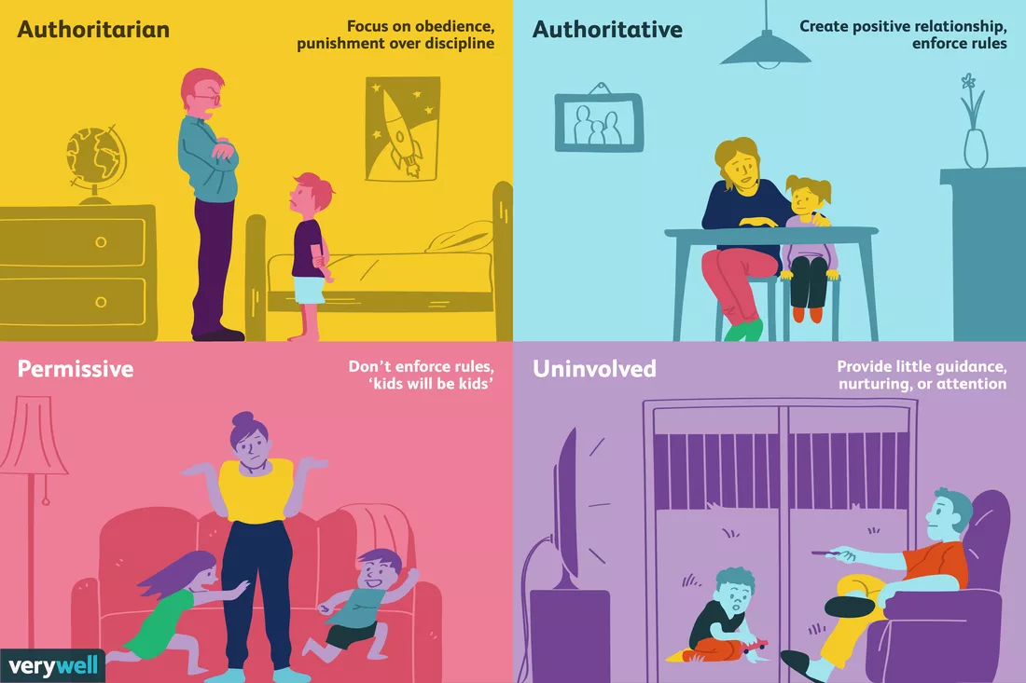
4 Parenting Styles
Notes:
3. Permissive Parenting
Do any of these statements sound like you?
You set rules but rarely enforce them.
You don't give out consequences very often.
You think your child will learn best with little interference from you.
If those statements sound familiar, you might be a permissive parent. Permissive parents are lenient. They often only step in when there's a serious problem.
They're quite forgiving and they adopt an attitude of "kids will be kids." When they do use consequences, they may not make those consequences stick. They might give privileges back if a child begs or they may allow a child to get out of time-out early if he promises to be good.
Permissive parents usually take on more of a friend role than a parent role. Higher risk of low self-esteem – at risk of unhealthy diet (junk food>obesity, dental decay)
4. Uninvolved Parenting
Do any of these statements sound familiar?
You don't ask your child about school or homework.
You rarely know where your child is or who she is with.
You don't spend much time with your child.
If those statements sound familiar, you might be an uninvolved parent. Uninvolved parents tend to have little knowledge of what their children are doing.
There tend to be few rules. Children may not receive much guidance, nurturing, and parental attention. Low self-esteem/confidence/poor behaviour/low academic.

Slide 18
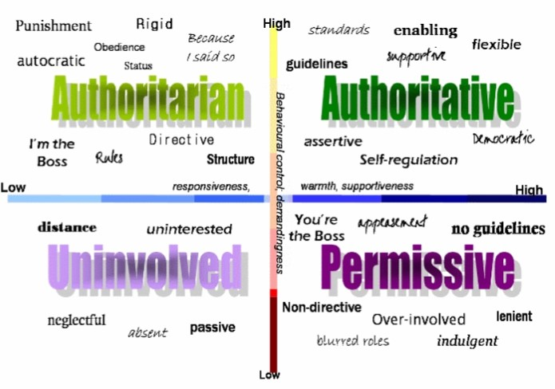
Knowing our Parenting Style(s)
Notes:
We may recognise parts of each style in ourselves – at different times, under different circumstances, although we typically have a dominant style. Good news is that our style is not set in stone and we can develop!
1. Authoritarian Parenting
Do any of these statements sound like you?
You believe kids should be seen and not heard.
When it comes to rules, you believe it's "my way or the highway."
You don't take your child's feelings into consideration.
Authoritarian parents are famous for saying, "Because I said so," when a child questions the reasons behind a rule. They are not interested in negotiating and their focus is on obedience. They also don't allow kids to get involved in problem-solving challenges or obstacles. Instead, they make the rules and enforce the consequences with little regard for a child's opinion. Higher risk of low self-esteem –opinions don’t matter.
2. Authoritative Parenting
Do any of these statements sound like you?
You put a lot of effort into creating and maintaining a positive relationship with your child.
You explain the reasons behind your rules.
You enforce rules and give consequences, but take your child's feelings into consideration.
Researchers who examine parenting styles have consistently found authoritative parents raise happier and healthier children who are equipped to face real-world challenges. They feel comfortable expressing their opinions/making good decisions.

Slide 19
Home Environment
Unconditional love- they need to feel it
I may not always like your behaviour but I always love you
Being the best they can be (not THE best)
Seeing a child as a whole child- celebrating who they are and their skills avoid focus being just the academic
Avoid drawing comparisons between siblings
Use of purposeful praise- praising effort rather than attainment
Choosing battles
Remaining calm
Encourage children to foster friendships and relationships
Encourage hobbies/ interests/ activity
1 to 1 time
We are helping our children move from parental control to self-control
Notes:
…Parenting Styles continued:
3. Permissive Parenting
Do any of these statements sound like you?
You set rules but rarely enforce them.
You don't give out consequences very often.
You think your child will learn best with little interference from you.
If those statements sound familiar, you might be a permissive parent. Permissive parents are lenient. They often only step in when there's a serious problem.
They're quite forgiving and they adopt an attitude of "kids will be kids." When they do use consequences, they may not make those consequences stick. They might give privileges back if a child begs or they may allow a child to get out of time-out early if he promises to be good.
Permissive parents usually take on more of a friend role than a parent role. Higher risk of low self-esteem – at risk of unhealthy diet (junk food>obesity, dental decay)
4. Uninvolved Parenting
Do any of these statements sound familiar?
You don't ask your child about school or homework.
You rarely know where your child is or who she is with.
You don't spend much time with your child.
If those statements sound familiar, you might be an uninvolved parent. Uninvolved parents tend to have little knowledge of what their children are doing.
There tend to be few rules. Children may not receive much guidance, nurturing, and parental attention. Low self-esteem/confidence/poor behaviour/low academic.

Slide 20
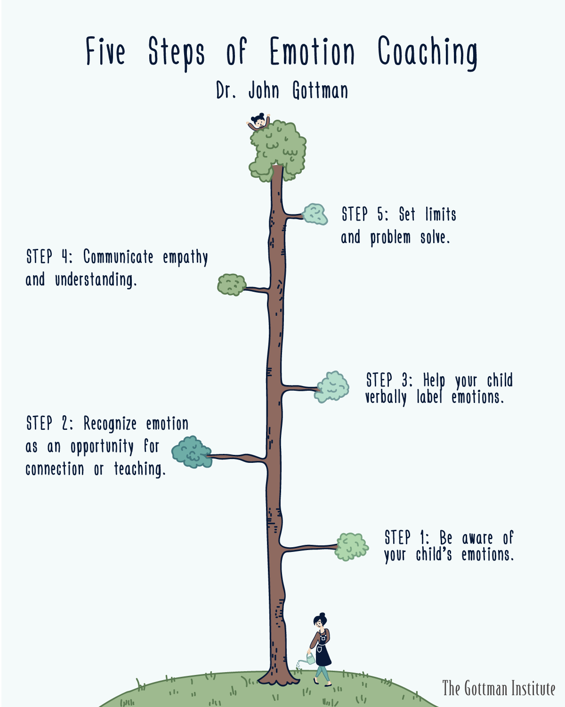
5 Steps of Emotion Coaching
Our Emotion Coaching Webinar:
https://www.youtube.com/watch?v=PFmudedDtgY&t=1047s
Supporting a worried or anxious child:
https://www.youtube.com/watch?v=xHaB4teA7QI&t=201s

Slide 21
Thank you for Joining us!
https://www.mindworks-surrey.org/
https://www.st-thomas.surrey.sch.uk/learning/looking-after-our-mental-health-and-wellbeing/

Slide 22
Who to Contact?
Mrs. Kate Carter, Head of School/DDSL
mrscarter@st-thomas.surrey.sch.uk
Mrs. Caroline McNiff, Inclusion Lead/SENCo/SLT
senco@st-thomas.surrey.sch.uk
Mrs. Jo Scott, HSLW/Mental Health Lead/Young Carers Lead
hslw@st-thomas.surrey.sch.uk

